Slide 1
OpenMP 4.0 Efficiency For Heterogeneous Parallel Programming
Jeffrey Douangpaseuth

Slide 2
What is Heterogeneous Parallel Programming?

Slide 3
What is Heterogeneous Parallel Programming?
Cooperative computing using various types of processors

Slide 4
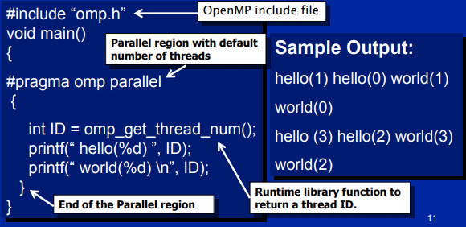
What is OpenMP?
API for multiprocessing programming
Compiler directives

Slide 5
New Features in OpenMP 4.0

Slide 6
Device Offloading
Computation delegation
target directive
Two target devices:
Graphical Processing Unit (GPU)
Knights Corner (KNC)

Slide 7
Device Data Environment
Logical separation of target and host memories
target map(direction: variable[begin:end]
target data map
target update to / from

Slide 8
Multiple Levels of Parallelism
Thread teams and task distribution
teams and distribute directives
SIMD instruction support
simd directive

Slide 9
Name the two levels of parallelism that are exposed by OpenMP 4.0’s new directives?

Slide 10
Name the two levels of parallelism that are exposed by OpenMP 4.0’s new directives?
Thread-Level Parallelism (Task-Level Parallelism)
Data-Level Parallelism

Slide 11
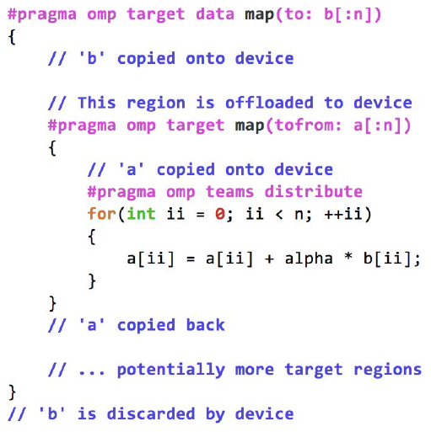

Slide 12
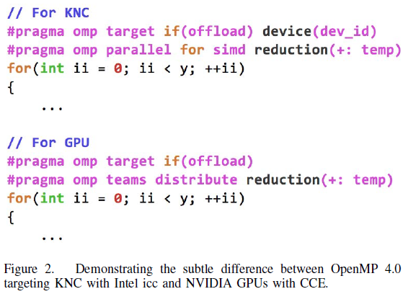

Slide 13
Performance Tests

Slide 14
Test Mini-Applications
TeaLeak
Implicit heat-conduction algorithm
Sparse linear algebra
Memory-bounded
CloverLeak
Euler hydrodynamics equations
Structured grid algebra
Memory-bounded
Bristol University Docking Engine (BUDE)
Molecule energy binding benchmark
Many math calculations
CPU-bounded

Slide 15
What is strong and weak scalability in HPC?

Slide 16
What is strong and weak scalability in HPC?
Strong Scalability
Computation time for a fixed-size total workload with respect to the number of processors
Weak Scalability
Computation time for a fixed-size workload per processor with respect to the number of processors

Slide 17
HPC Test Devices
Cray XC40 supercomputer
Intel Xeon Haswell CPU E5-2698 v3
NVIDIA K20X GPU

Slide 18
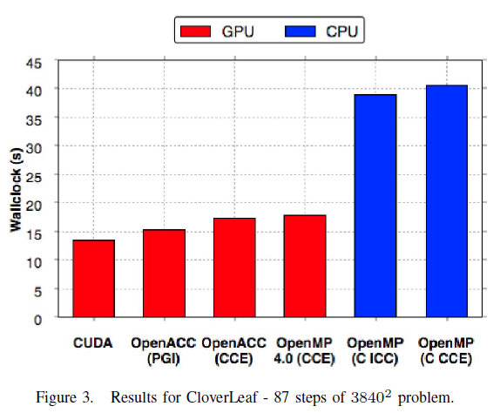
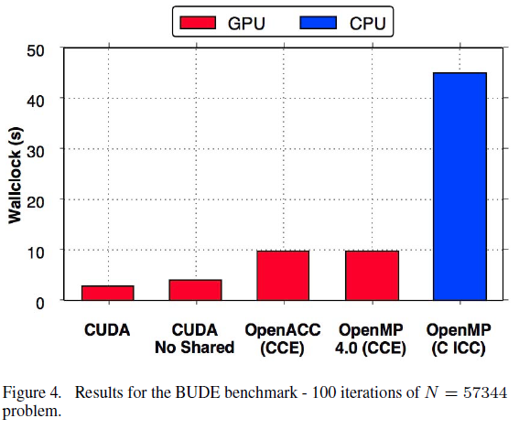
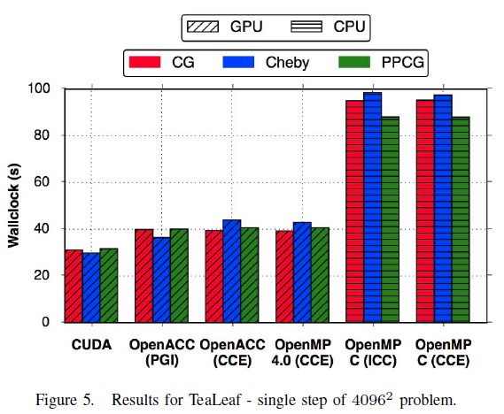

Slide 19
Why do you think CPU performance is so bad for these tests?

Slide 20
Why do you think CPU performance is so bad for these tests?
These tests are much more independently parallelizable which cater more towards GPUs

Slide 21
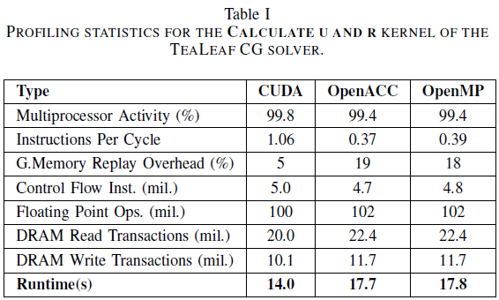
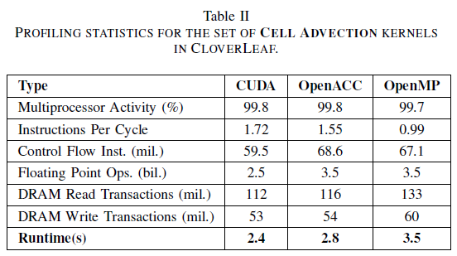
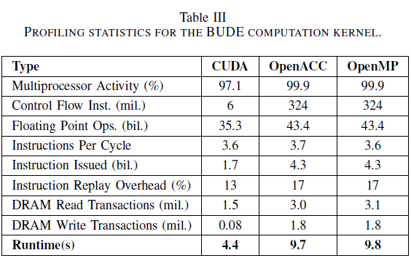

Slide 22
What are some advantages of having multiple test applications?

Slide 23
What are some advantages of having multiple test applications?
Much easier to recognize and understand irregularities in results
Recognize similarities and/or differences that would otherwise not be apparent using one test
etc

Slide 24
How is it related to what you learned?
Insight on the current state of some tools used for heterogeneous parallel processing
Understanding pros and cons between parallel programming tools
Optimizations differences between devices
Importance of multiple test cases

Slide 25
References
[1] M. Martineau, S. McIntosh-Smith and W. Gaudin, "Evaluating OpenMP 4.0's Effectiveness as a Heterogeneous Parallel Programming Model," 2016 IEEE International Parallel and Distributed Processing Symposium Workshops (IPDPSW), Chicago, IL, 2016, pp. 338-347
[2] A. Shan (2006) Heterogeneous Processing: a Strategy for Augmenting Moore’s Law [Online] www.linuxjournal.com/article/8368
[3] T. Mattson, L. Meadows (2013) A “Hands-on” Introduction to OpenMP [Online] https://www.cs.uaf.edu/2013/fall/cs441/OpenMP-SC08.pdf
[4] G. Chrysos (2012) Intel Xeon Phi X100 Family Coprocessor – the Architecture [Online] https://software.intel.com/en-us/articles/intel-xeon-phi-coprocessor-codename-knights-corner
[5] The University of Edinburgh (2017) Lect. 2: Types of Parallelism [Online] www.inf.ed.ac.uk/teaching/courses/pa/Notes/lecture02-types.pdf
[6] I.J. Bush, W. Smith (2014) CSE – The Weak Scaling of DL_POLY 3 [Online] https://web.archive.org/web/20140307224104/http://www.stfc.ac.uk/cse/25052.aspx

Slide 26

Question Period

